Slide 1
Contribution to "Systematic review generator"
Alexandru Pintea

Slide 2
Aim 1: Feature extraction / ranking
(03/02 - 17/02)

Slide 3
Initial feature retrieval (PubMed only)
- Using the PMID from the CSV files I had, I fetched all the data that PubMed gave me
- The object that PubMed returned had functions/properties in it, from which all the properties were put in a Pandas Dataframe

Slide 4
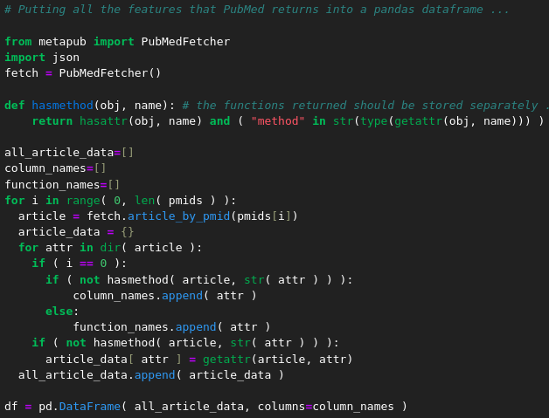

Slide 5
Initial feature retrieval (PubMed only)
- Drop the features that have the same value for all rows
- This is done with the "frequency" and "count" rows of the df.describe() table

Slide 6
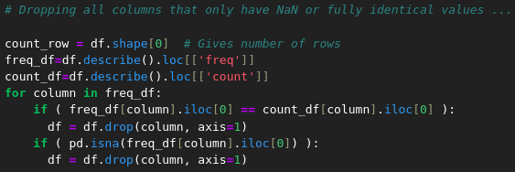

Slide 7
Initial feature retrieval (PubMed only)
- Remove columns containing redundant information
- e.g. leave only "authors" from the "author_list", "authors_str" and "authors" columns

Slide 8
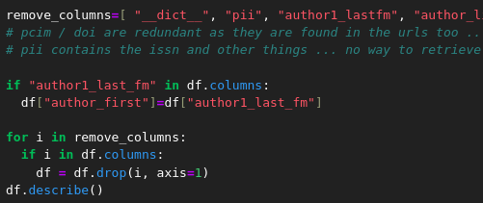

Slide 9
Initial feature retrieval (PubMed only)
- Retrieve and structure reference data in a JSON, if available in the XML object that PubMed provided
- Here I could attempt to retrieve references from somewhere else, if PubMed does not have them …

Slide 10
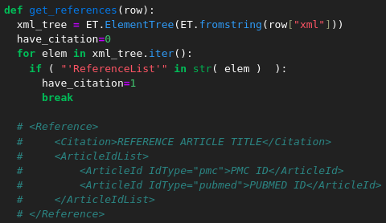

Slide 11
Initial feature retrieval (PubMed only)
- To generate keywords for the about 60% of articles that had none, the following method was used:
0. removing all the common words from the title (done using lists of common words from wiki)
1. going though all the keywords that were found (from the articles that had them), to make a list of non-generated keywords/phrases
2. adding non-generated keywords/phrases to an article without keywords if they appear in its title
3. adding the final non-common title words to the keywords (the ones that remained = were not common and were not in non-generated keywords/phrases)

Slide 12
Initial feature retrieval (PubMed only)
- 23629 stop words (common words) were taken from Wikipedia to help identify the medical terms of the title, by means of exclusion
- Then, all the existing (non-generated) citations were put into an array

Slide 13
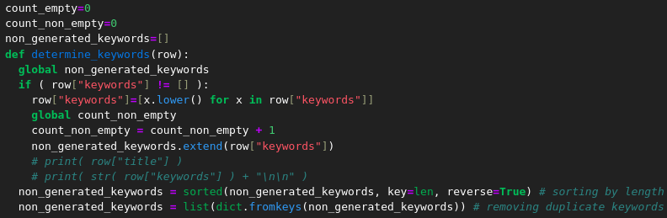

Slide 14
Initial feature retrieval (PubMed only)
- The titles of all the articles without keywords were parsed, in search of the identified keywords, from the previously mentioned array

Slide 15
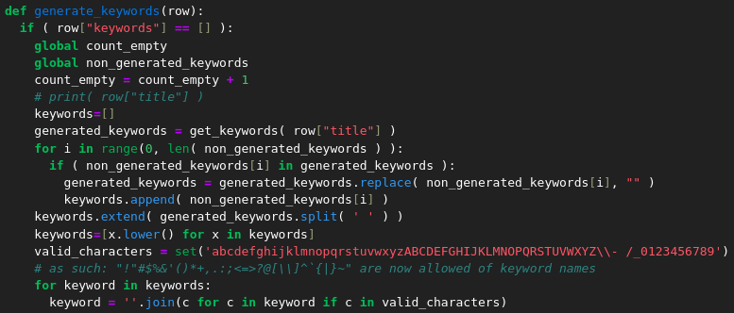

Slide 16
Initial feature retrieval (PubMed only)
- All the data that could've been retrieved through the ISSN was saved in a JSON, within a dataframe column

Slide 17
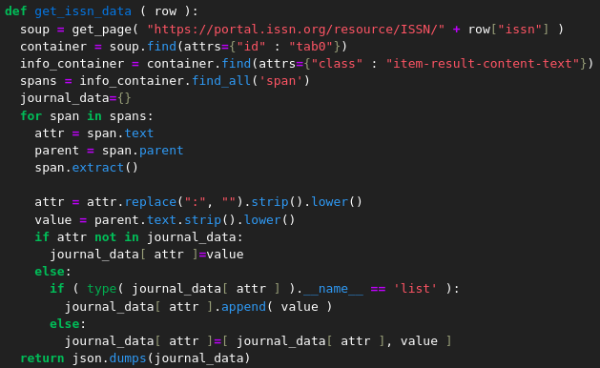

Slide 18
Initial feature retrieval (PubMed only)
- All dataframe columns were converted to string, so as to remove duplicated without errors …
- Duplicate removal shall be done when PMIDs are selected in the beginning, not at the end like it is done now …
- Finally, 2 CSV files were saved:
- one with the full contents of the dataframe
- another with data for citation network building

Slide 19
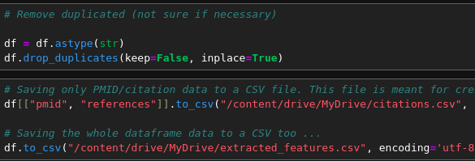

Slide 20
Final "Aim 1" tasks (done until 17/02)
DONE: Merge initial CSV data with the Pandas dataframe
DONE: Input all the PMIDs from all the CSVs, remove duplicates, then retrieve features
- Use the API for retrieving full article texts though the article PMC number (maybe API for ISSN and others too …)
- Use feature ranking tools/feature correlation to rank all determined features

Slide 21
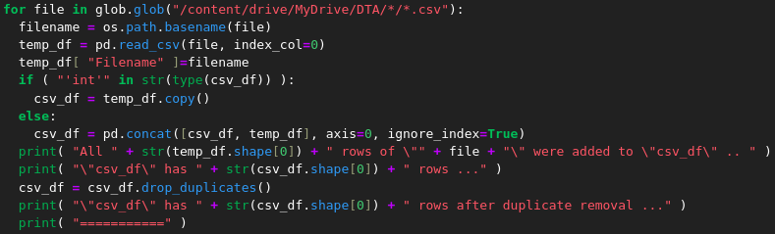
Input PMIDs from all the CSVs

Slide 22
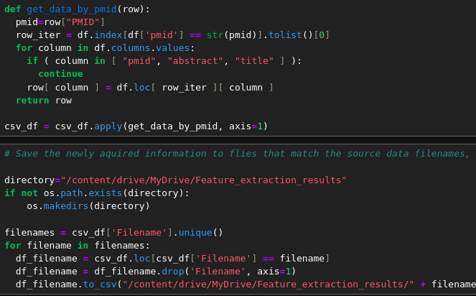
Add retrieved features to initial CSVs

Slide 23
Aim 2: LLM and query-based corpus creation
(17/02 - 10/03)

Slide 24
Article generation (17/02 - 24/02)
- Prompts shall be formulated based on article screening questions, in order to generate several "positive"/"negative" articles using both LLMs and a query-based method
- Classifiers shall be trained on each of the types of articles generated/retrieved (LLM/query-based)
- The classifier that proves itself superior in performance shall determine which article generation/retrieval method is superior (LLM/query-based)
- The chosen article generation/retrieval method shall be used at a larger scale to provide a viable corpus for accurate classifier training

Slide 25
Article generation (24/02 - 03/03)
- Input the generated/retrieved articles into the feature extraction code from "Aim 1", to generate a CSV containing all article features
- Train a model on the features considered the most relevant
- See if any of the features extracted can help formulate a summary of the articles generated/retrieved

Slide 26
Article generation (03/03 - 10/03)
- Output synthetic literature reviews (complex tasks that needs to connect many application parts together)
- If "Aim 2" can be considered achieved, move on with the next week's tasks and write text meant for the final coursework

Slide 27
Aim 3: Citation network creation
(10/03 - 24/03)

Slide 28
Citation network (10/03 - 17/03)
- use an embedding space to represent all the citation data gathered so far
- use the embedding space to make a citation network
- train a classifier to discern between a "positive"/"negative" article relying solely on citation networks (complex task)

Slide 29
Citation network (17/03 - 24/03)
- use the output of the citation network classifier along with the output of the rest of the features to decide whether an article is "positive"/negative (complex task)
- if "Aim 3" can be considered achieved, move on with the next week's tasks and write text meant for the final coursework

Slide 30
Aim 4: Document the project within the final coursework
(24/03 - 19/04)

Slide 31
Final coursework (17/03 - 24/03)
- finish up any tasks that were left unfinished so far
- write text/figures for the final coursework (finish it)
- make a short presentation and application demo (coursework 2)
- discuss further personal involvement with the systematic revie generation project with my supervisor

Slide 32
Thank you for your attention!

